Slide 1

RentRide : A Vehicle Rental Platform
GUDIED BY:
DR.JAYASAKTHI VELMURUGAN
Done By:
K.DINESH(192210140)
T.MANOHAR(192210122)

Slide 2

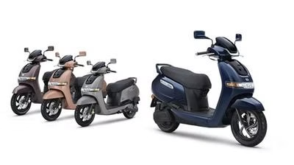
AIM AND CHALLENGES:
The website should be easy to navigate, have clear calls to action, and be responsive on mobile
.
Providing a user-friendly interface
The website should allow users to search for
available cars, view profiles, and book cars for a
specified period

Slide 3


About RentRide
RentRide is a platform or service that allows people to rent vehicles, like cars, bikes, or scooters, for a specific period instead of owning them. It’s designed to make transportation easy and accessible for those who don't own a vehicle or need one temporarily, like for a trip or a short commute.

Slide 4

Frontend:
HTML, CSS, and JavaScript for building the responsive and visually appealing user interface.
Backend:
PHP for implementing server-side logic, handling business rules, and integrating with the database.
Third-Party Integrations
Leverage APIs and SDKs to seamlessly integrate payment gateways, shipping providers, and other essential services.

Slide 5

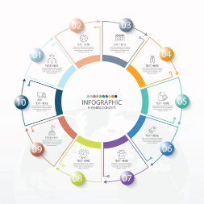
How RentRide Works
Search
Drive
Browse our extensive selection of vehicles and find the perfect one for your needs.
Pick up your vehicle at your chosen location and enjoy the freedom of the open road.
1
2
3
Reserve
Easily book your rental online through our web site, securing your vehicle for your desired dates.

Slide 6
Benefits of rental Vehicle's:
Flexibility
Easy booking
Comfort
Budget travel
Cost saving
Customized rental packages
Multiple cars
Better Security
Choose your car
DISADVANTAGES FOR EXISTING APPLICATIONS:
Environmental Concerns
Geographical Restrictions
Limited Customization
Maintenance and Condition

Slide 7





Rent with Ease
Flexible Booking
Reserve your vehicle for as little as a few hours or as long as a few weeks.
Convenient Locations
Pick up and drop off your rental at any of our strategically placed branches.
24/7 Support
Our friendly customer service team is available around the clock to assist you.

Slide 8
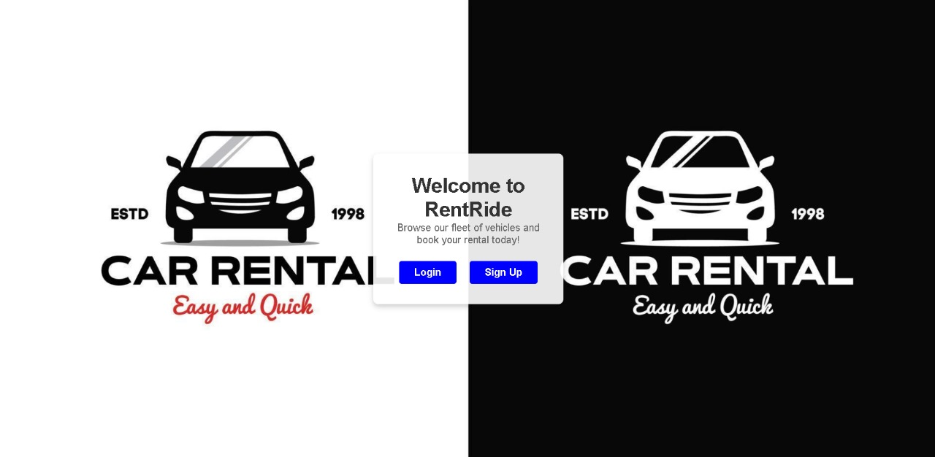

Slide 9
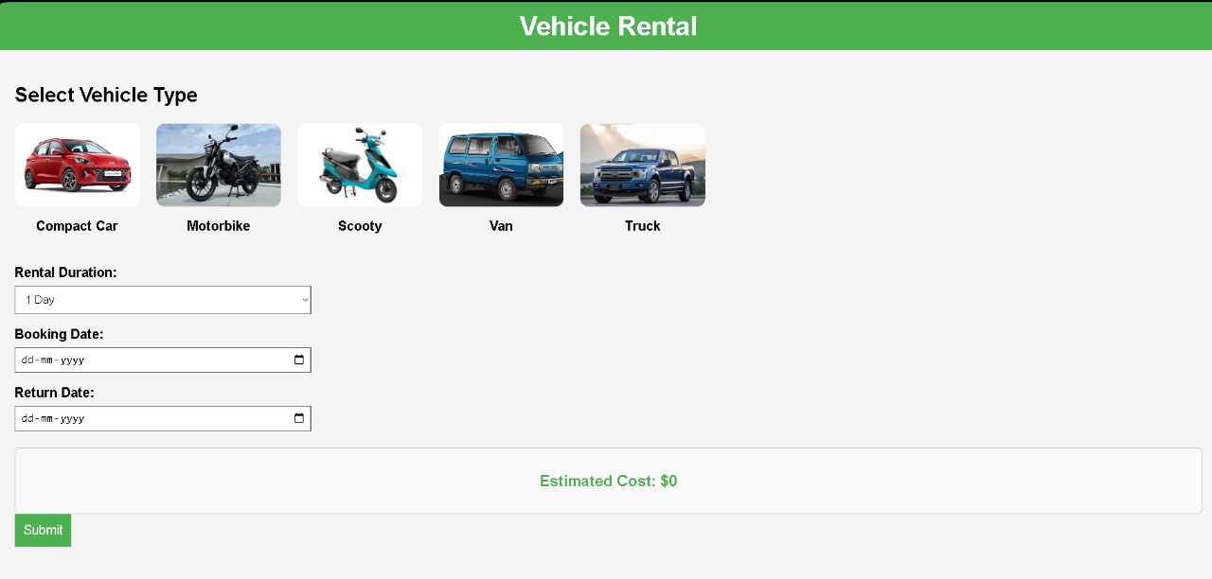

Slide 10
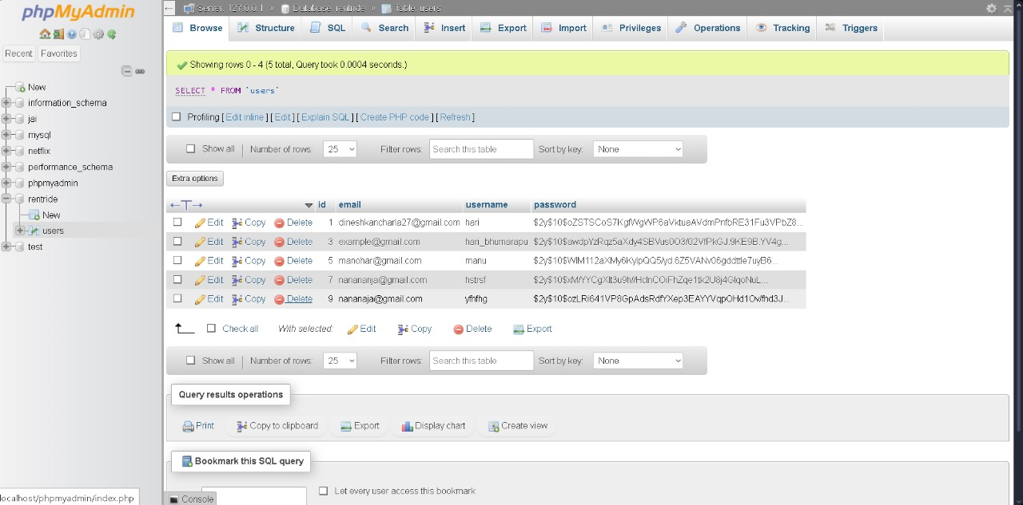

Slide 11
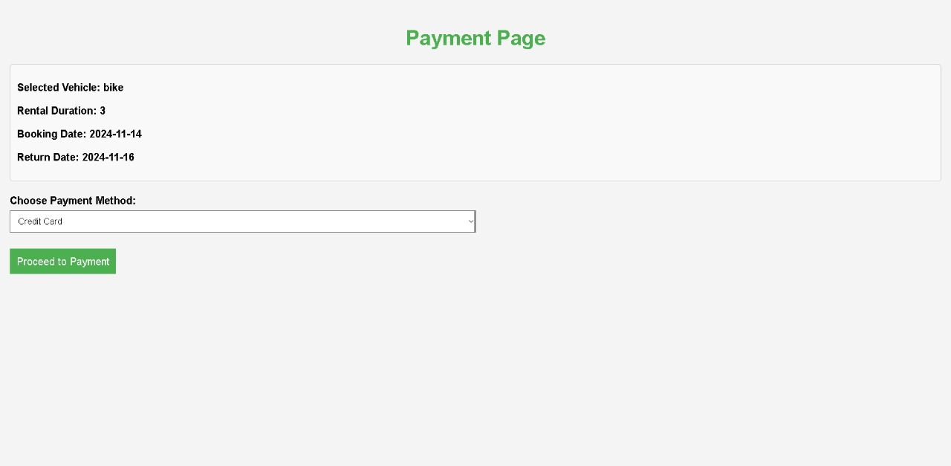
Reliable and Affordable
Vechicle Maintanence
Competitive Rates
We offer transparent pricing and various package options to fit your budget and travel needs.
Our vehicles undergo thorough inspections and regular servicing to ensure a safe and smooth ride.
Peace of Mind
Eco-Friendly Options
Enjoy the confidence of renting from a reputable provider with comprehensive insurance coverage.
Explore our selection of hybrid and electric vehicles to minimize your environmental impact.

Slide 12
FUTURE IMPROVEMENTS:
In the application we try to get the multi language for everyone to use.
Improved Vehicle Maintenance & Safety Standards.
Seamless End-to-End User Experience.
Sustainable and Electric Fleet Expansion.
Blockchain for Transparent Transactions.

Slide 13
Conclusion
1
Your Ride, Your Way
2
Explore the World
3
Join the Movement
RentRide is your one-stop-shop for all your transportation needs, offering a seamless and personalized rental experience.
Whether you're planning a road trip, a business trip, or a family getaway, RentRide has the perfect vehicle to get you there.
Experience the convenience, reliability, and affordability that RentRide provides. Start your journey with us today!

Slide 14


